Slide 1
Tax on Inheritance & Estate Planning Strategies
By:
Atty. Benedict R. Tugonon
Senior Partner, Head of Tax Group
Quiason Makalintal Barot Torres
Ibarra Sison & Damaso Law Firm

Slide 2
Legal Notice & Disclaimer
The presentation is not a form of legal advice. The organizers, the presenter, and the Law Firm of Quiason Makalintal Barot Torres Ibarra Sison & Damaso, shall not be liable for any claims or damages arising from any matter contained in the presentation. Securing professional advice or counselling before undertaking any plan is highly recommended.

Slide 3
What to expect today?
What’s new in TRAIN & CREATE Laws?
Common issues in Estate Planning

Slide 4
What to expect today?
Estate Planning options
Insights from actual experiences

Slide 5
New Laws TRAIN & CREATE

Slide 6
REPUBLIC ACT 10963
TAX REFORM FOR ACCELERATION & INCLUSION ACT (TRAIN)

Slide 7
REPUBLIC ACT 11534
CORPORATE RECOVERY AND TAX INCENTIVES FOR ENTERPRISES (CREATE)

Slide 8
Estate Tax

Slide 9
Estate Tax
6% of net estate
5M Standard Deduction
10M family home deduction

Slide 10
Valuation of Real Properties: Estate
Higher between the BIR Zonal Value or the tax declaration market value

Slide 11
Valuation of Shares: Estate
UNLISTED shares in corporations with real properties -
Book Value per AFS
No need to appraise real properties

Slide 12
Estate Tax Deduction
50% Share of the Surviving Spouse in the Net Conjugal or Absolute Community Estate
5

Slide 13
Estate Tax – Bank Deposit Withdrawal
Withdrawal of deposit account allowed, subject to 6% final withholding tax
- without benefit of the 5Million standard deduction

Slide 14
Estate Tax Due Date
Due date 1 year after death
May be paid in 2-yr installment – with no interest

Slide 15
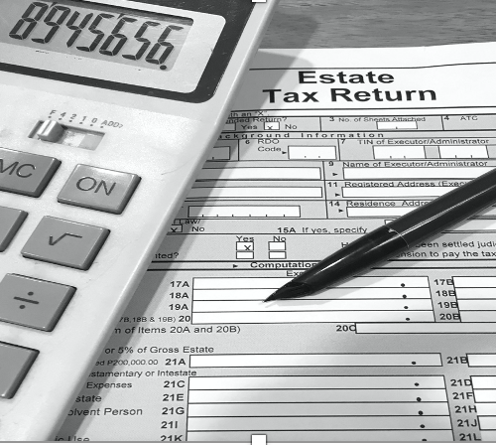
Estate Tax Payment Source
Cash/Deposits of Deceased
Advances from Heirs
Proceeds from Life Insurance policies
Proceeds from sale of estate assets

Slide 16
Settlement of the Estate
Extrajudicial Partition if there is consensus among heirs
Litigation if no consensus or agreement, which is time consuming, costly and tedious

Slide 17
Probate of Wills
If deceased made a Will, notarial or holographic -
Probate Proceedings (Court Litigation)
Requires appointment of Executor
Take years to complete, and prone to further delays

Slide 18
Estate Tax Amnesty Extension
6% amnesty tax
Valued at the time of death
Deductions applicable at the time of death

Slide 19
Estate Tax Amnesty
Availment Period - until June 14, 2023
Application first before payment
CAR will be issued after payment

Slide 20
ESTATE TAX AMNESTY EXTENSION
Can be availed even before Settlement and Partition

Slide 21
Donation/Gift

Slide 22
Donation/Gift
Purely out of love & generosity
Cash
Property (real & personal)
Shares, Bonds
Jewelry

Slide 23
Donor’s Tax
Not over P250K per year – EXEMPT
6% rate in excess of P250K
Uniform rate regardless of relationship of donor and donee

Slide 24
Valuation of Real Properties: Donation
Higher between the BIR Zonal Value or the tax declaration market value

Slide 25
Valuation of Shares: Donation
UNLISTED shares in corporations with real properties
Book value only in latest AFS
No need to appraise real properties

Slide 26
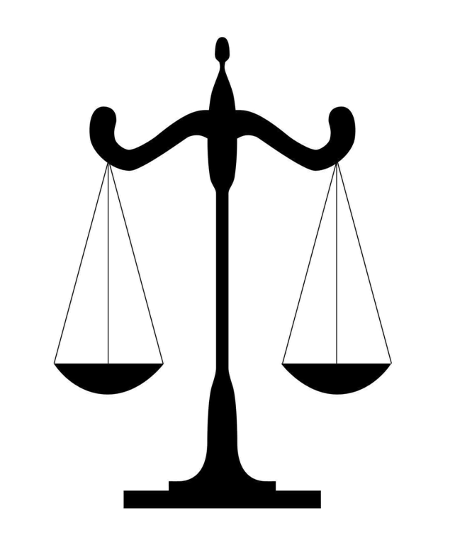
6% Estate Tax VS. 6% Donor’s Tax
More deductions for Estate Tax i.e., 5M
Donor’s tax on PRESENT VALUE
Estate tax on FUTURE VALUE at time of death

Slide 27
Documentary Stamp Tax on Donation
DST on Donation of Shares P1.50/P200 of par value
DST on Donation of real property sale - P15/P1000 of tax base

Slide 28
Issues to Consider in Donation
Only the Free Portion can be donated freely
Subject to the rights of Compulsory or Forced Heirs to Legitime

Slide 29
Benefits of Donation to Children
No issue on financial capacity of children

Slide 30
Issues in Donating to Children
WITHOUT pre-nup. – donation BEFORE wedding, co-owned with spouse of children
Donate AFTER & ONLY to children, exclude their spouses

Slide 31
Issues in Donating to Children
No more control by Donor
Usufruct agreement during Donor’s lifetime

Slide 32
Sale of Assets

Slide 33
Sale of Assets
Sell assets, real or personal properties, stocks, shares in family corporations
Sell to children
Sell to third parties for liquidity and leave cash

Slide 34
Taxes on Sale of Shares - Listed
If listed shares – .6 of 1% Stock Transaction Tax plus brokers’ fees
Exempt from DST

Slide 35
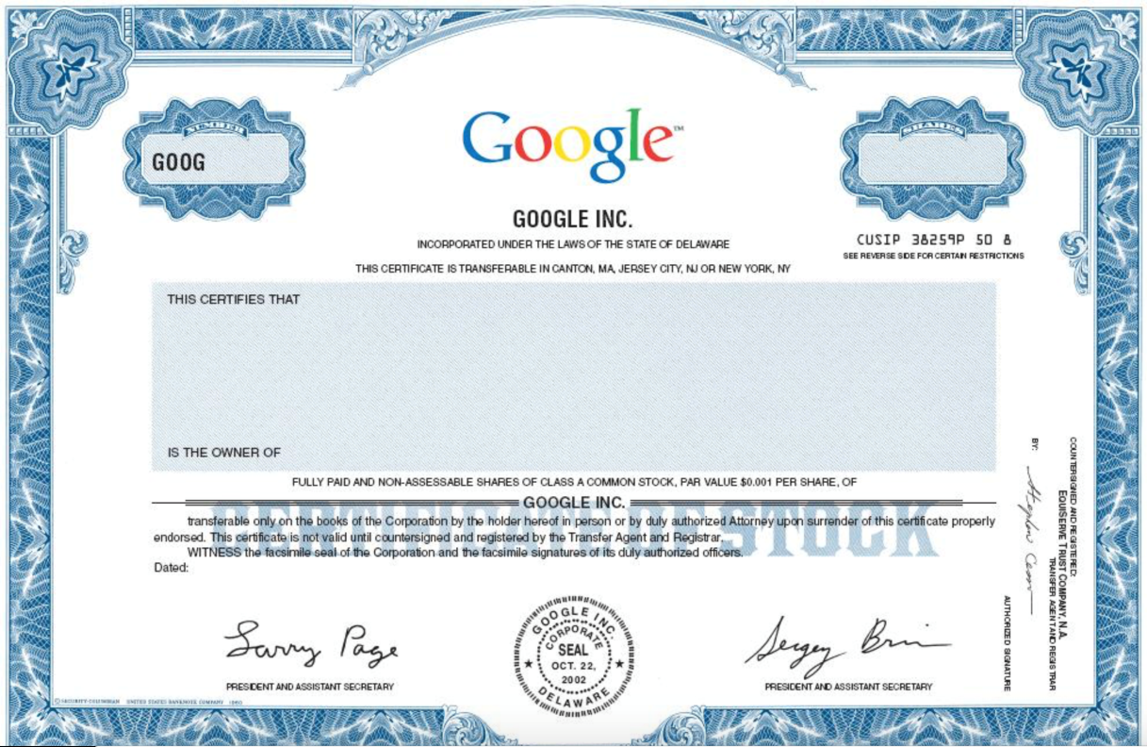
Taxes on Sale of Shares - Unlisted
Capital Gains Tax – 15% of net gain
DST at P1.50/P200 of par value of fraction

Slide 36
Valuation of Shares for Sale
If unlisted shares – Book Value per latest AFS
If listed shares – Trading Price at PSE

Slide 37
NEW On Sale of Shares
RR 20-2020 – Book value per latest AFS ONLY!
No need for Appraisal of real properties owned by the corporation
Capital Gains Tax will be lesser (no adjustment on real property valuation gain)

Slide 38
Sale Real Properties
Capital Assets (not used in business) –Residence, vacation house, idle land, vacant lot of one not in real estate business/lessor
Ordinary Assets (used in business)

Slide 39
Sale Real Properties - Capital
6% CGT (final tax)
DST on Sale of real property sale - P15/P1000 of tax base

Slide 40
Sale of Assets Before Death
Sell idle or unused assets and stay liquid
Cash is easier to use and dispose

Slide 41
Sale of Assets Before Death
Bank secrecy protects deposit from inquiry
Banks abroad are outside PH jurisdiction

Slide 42
Capital Asset vs. Ordinary asset?

Slide 43
Sale of Real Properties - Ordinary
6% CWT – creditable against the 0-35% Income Tax or 20% - 25% Corporate Income Tax
12% VAT or 3% Percentage Tax
DST on Sale of real property sale - P15/P1000 of tax base

Slide 44
Incorporation

Slide 45
Putting Assets in Corporation
Transfer of Assets:
- Direct Sale; or
- Tax-free exchange for shares
Ideal for business assets to keep under family control
Children can become shareholders in the Corporation

Slide 46
Sec. 40 C (2) NIRC Amended by CREATE
No gain or loss shall be recognized a corporation OR ON ITS STOCK OR SECURITIES,

Slide 47
Sec. 40 C (2) NIRC
if such corporation is a party to a reorganization and exchanges property in pursuance of a plan of reorganization solely solely for stock in a corporation, which is a party to the reorganization.

Slide 48
Sec. 40 C (2) NIRC
Control – 51% of total voting power of all classes of stocks entitled to vote.

Slide 49
Taxes on Sale of Shares - Unlisted
Capital Gains Tax – 15% of net gain (Based on Book Value only)
DST at P1.50/P200 of par value of fraction

Slide 50
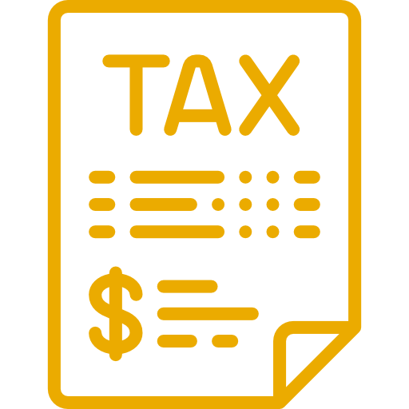
Issues Incorporation of Assets
Real properties transferred to Corporation, subject to higher taxes if sold by Corporation
Not ideal for capital asset – not used in business

Slide 51
Trust

Slide 52
Put Assets in a Trust
Trustee – a bank, private firm, lawyer,
or etc.
Revocable or Irrevocable
Trustee may be local or offshore

Slide 53
Tax Consequences of Trusts
 | REVOCABLE | IRREVOCABLE
Donor’s Tax on Transfer of Assets to Trust | No Donor’s Tax | Subject to Donor’s Tax
Estate Tax Upon Death of Trustor | Subject to Estate Tax | No Estate Tax

Slide 54
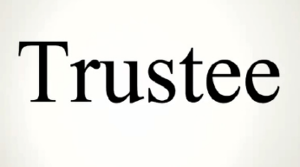
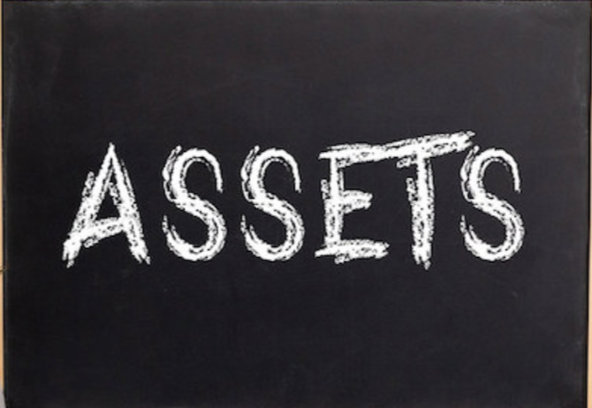
Advantages of a Trust
Beneficiaries are identified
Settles ownership and succession issues
No need for probate proceedings

Slide 55
Waiver of Inheritance

Slide 56
Waiver of Inheritance
Waive INHERITANCE to co-heirs
Spouse will just retain 50% conjugal share only
Not subject to donor’s tax

Slide 57
Intestate Distribution
Conjugal Properties
Surviving Spouse
Child
Child
Husband
Wife
Surviving Spouse
Child
Child
Child
Child

Slide 58
Life Insurance

Slide 59
Life Insurance
Provide liquidity to heirs
Source of Estate Tax Payment
Funds to equalize and/or satisfy Legitime

Slide 60
Tax Consequences of Life Insurance
Designation of Beneficiaries | REVOCABLE | IRREVOCABLE
Income Tax on Proceeds | Exempt | Exempt
Estate Tax | Subject to Estate Tax | Exempt

Slide 61
Estate Tax Planning Tips

Slide 62
Estate Tax Planning Tips
Real estate with income
Incorporate via tax-free transfer
Sell or donate shares to children
Idle or residential properties
Sell or donate to heirs or 3rd parties
Maintain as “Capital Asset”

Slide 63
Estate Tax Planning Tips
Shares of stock
Sell or donate to heirs
Cars/Motor Vehicles
Sell or donate to heirs

Slide 64
Estate Tax Planning Tips
Bank Deposits
Enroll in online banking & link accounts of heirs

Slide 65
Financial Planning
Stock market gains taxed only at .6 of 1% of -transaction value
Redemption gains from mutual funds not subject to Income Tax
Long term bonds (5-yrs) are exempt from income tax

Slide 66
WILL Execution

Slide 67
Do I need to write a will?
NO
If OK with equal distribution or per law
To avoid costly & complicated probate

Slide 68
Do I need to write a will?
YES
To disinherit an heir
To distribute FREE PORTION differently

Slide 69
Intestate Succession

Slide 70
Settlement – Without a WILL
- Execution of Deed of Partition by heirs
Consensus among heirs necessary
Notice of partition is published

Slide 71
Key Takeaways
With estate tax rate now at 6%, plus the deductions, avoiding the estate tax should no longer be the main reason to do estate planning
Look at the bigger picture, other legal issues (legitime, property regime & others) should be considered, not just tax

Slide 72
Key Takeaways
Cash, liquid assets, including proceeds from life insurance are easier to transfer and can be used to equalize or reach fair sharing among heirs
There is no one fit-all strategy in estate planning. Identify what is important to you and the family

Slide 73
Key Takeaways
Align plans with the next generation, don’t waste time and money to transfer assets, which your intended beneficiaries are not interested
A peaceful family can transfer wealth efficiently than a family with conflicts and issues

Slide 74
Thank you!

Slide 75
Atty. Benedict R. Tugonon
Bachelors of Law (1999) and AB Philosophy & Letters (1995) – San Beda College Manila
Partner & Head of Tax Practice, Quiason Makalintal Barot Torres Ibarra Sison & Damaso Law Firm
Past President (2016), Tax Management Association of the Philippines
Speaker on Tax Audit – Philippine Experience during the 3rd International Tax Convention and Asia-Oceania Tax Consultants’ Association (AOTCA) conference, JW Marriot Hotel, Seoul, South Korea,
Listed as among the Leading Individuals in Tax for the Philippines in the 2017 edition of Chambers Asia Pacific, A Client’s Guide, Asia-Pacific’s Leading Lawyers for Business, published by Chambers & Partners, London.
Mentioned in Legal500.com, a London-based legal publication containing legal market information based on client and peer reviews, as very experienced in taxation in the Philippines, with the Law Firm classified as a second tier Philippine tax law firm.
www.qmbti.com

